Slide 1
CST-235 Computer Programming III
Topic 4 (3 weeks)

Slide 2
Lectures for Topic 4
Lectures:
Data Access Layer:
Intro to the Data Access Layer and JDBC => Week 1
More JDBC => Week 2
JPA => Week 3
Hands On:
Setup a JavaDB/Derby Database in the IDE.
Connecting to the Database and running simple Queries.
Connecting to the Database and running Insert/Update Statements.
Writing a Data Access Object in Java.

Slide 3
Lectures for Topic 4 – Week 1
Lectures:
Topic 4 Project Assignment Requirements.
Data Access Layer:
Intro to JDBC
Making a Connection to a Database in Java
Hands On:
Setup a JavaDB/Derby Database in the IDE.
Connecting to the Database and running simple Queries.

Slide 4
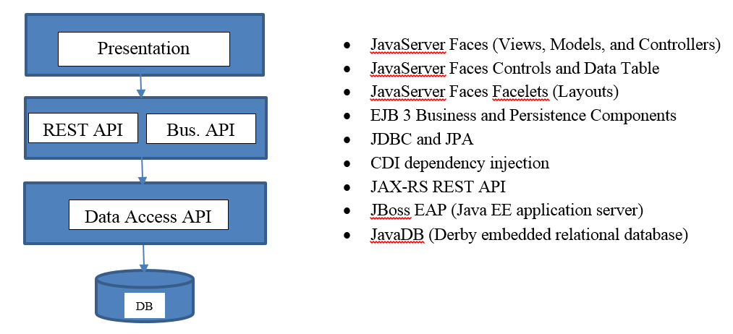
Project Overview
In this class you will design and build a complete enterprise class N-Layer application using Enterprise Java technologies, that meets a certain set of functional and technical requirements, and as shown in the figure below.
The Class Project has changed!

Slide 5
Review Topic 4 Assignment Requirements
Please pull up the Assignment #4 from the Announcement
Review the Requirements
The Class Project has changed. Please pull up the Project Requirements from the Assignment.

Slide 6
Intro to the Data Access Layer and JDBC

Slide 7

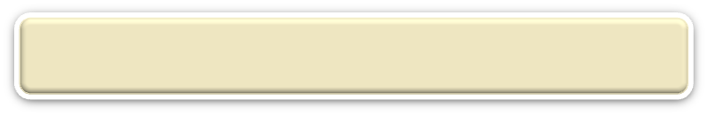
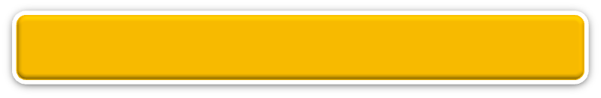
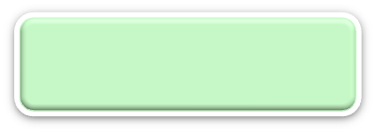


N-Layer Architecture
RIA Design
Client Layer (Desktop/Mobile/Browser)
User Interface, (Minimal) Client Side Validation, AJAX, UI Rules
AJAX
jQuery
CSS
Forms
HTTP/HTTPS POST
Event Based Design
Presentation Layer (PL)
User Interface, UI Event Handlers, UI Rules, Navigation
JSF
Data Validators
Canonical Object Model
Local POJO, SOAP, REST
Design By Contract
Business/Services Layer (BLL)
Business Logic, Business Rules, Workflow, Data Validation
EJB
IoC/CDI
JAX-WS and JAX-RS
Canonical Object Model
Canonical Object Model
This layer is all about handling interactions with Database
Optional SOAP, REST
SOAP, REST
Entity Driven Design
Data Access/Services Layer (DAL)
CRUD Data Persistence
Integration Tier
Orchestration
(Workflow*, Rules*)
Entity Beans (ORM)
Hibernate
JDBC
Data Access Objects
Data Model
JMS, SOAP, .JAXB, Spring
Cache
Operational
Database
External Systems
Interfaces, Feeds, Printers
Business Entity
Media

Slide 8
How can I interact with the Database?
Java (and the Open Source Community) have a number of API’s, libraries, and framework for reading, inserting, updating, and deleting data to/from a relational database.
These options include but are not limited to:
JDBC – the oldest and lowest level API
JPA – standards based Object Relational Model (ORM) specification
Hibernate – ORM that can be used with JPA as a JPA Provider
Spring Data – ORM that can be used with JPA as a JPA Provider
Since you have not learned JDBC we will be replacing JPA with JDBC in this class.

Slide 9
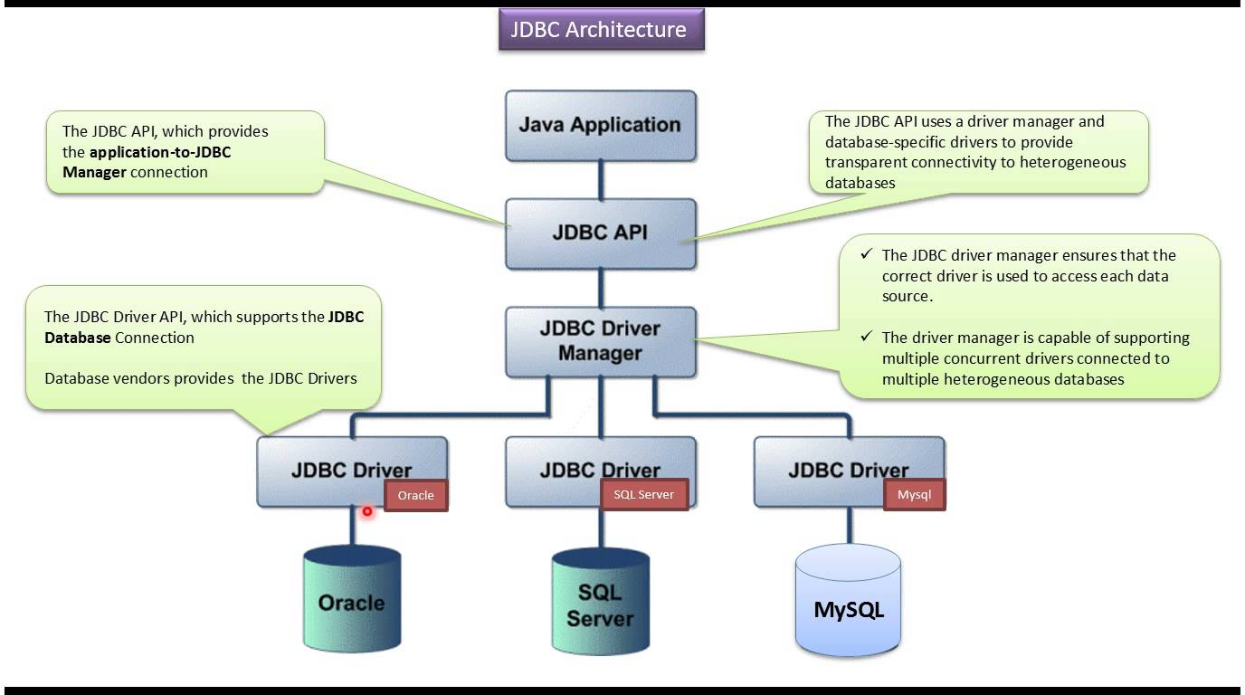
What does the JDBC Architecture look like?
All JDBC compliant JDBC Drivers must support this API!
As long as your write cross database compliant SQL you could actually change databases along with the driver and your Java code would work!

Slide 10
What are some classes that are in the JDBC API?
DriverManager: This class manages a list of database drivers. It is used to establish a database Connection.
Driver: This interface handles the communications with the database server. You will interact directly with Driver objects very rarely. Instead, you use a DriverManager object, which manages objects of this type. It also abstracts the details associated with working with Driver objects.
Connection: This interface has all the methods for connecting with a database. All communication with database is done through connection object only.
Statement: You use objects created from this interface to submit the SQL statements to the database. Some derived interfaces accept parameters (i.e. Prepared Statements).
ResultSet: These objects hold data retrieved from a database after you execute an SQL query using Statement objects. It acts as an iterator to allow you to move through records of the data that has been returned from a query.
SQLException: This class handles any errors that occur in a database application.

Slide 11
How do I interact with a Database?
Connect to the Database and a desired schema.
Execute one or more SQL Statements.
Process data or errors returns from the Database.
Close the connection to the Database.
Return data to the Application.
This is similar to what you have been doing in PHP.

Slide 12
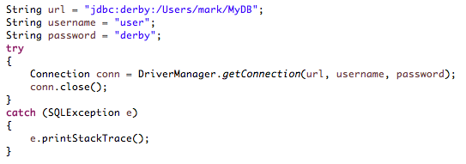
How do I connect to a Database?
The URL format will change depending on your database vendor and database driver
Database URL
and Login Credentials
Get a Connection from the Database
We are forced to catch exceptions in a Try Catch Block
Use the Connection and when done make sure to close it!

Slide 13
In-Class Activity
Configure JavaDB in our IDE!
Complete the In-Class Activity #4a that I posted in an Announcement.
Create a database using JBoss Developer Studio.

Slide 14
End of Class

Slide 15
How do I query data from the Database?
Database URL
and Login Credentials
Get a Connection from the Driver Manager
Create a Statement from the Connection and execute Query
Loop over Result Set and read column data
Close Result Set

Slide 16
How do I insert data into the Database?
Same sequence of steps as running a Query but you use the exectuteUpdate() to run your insert SQL

Slide 17
How do I cleanup the Database Connection?
Catch all SQL Exceptions. Log the error and throw an unchecked exception back up.
Easiest approach is to just put all cleanup in a finally block.

Slide 18
In-Class Activity
Configure JavaDB in our IDE!
Complete the In-Class Activity #4a that I posted in an Announcement.
Create a database using JBoss Developer Studio.

Slide 19
In-Class Activity
Use JDBC to Connect to a Database!
Complete the In-Class Activity #4d (Part 1) that I posted in an Announcement.
Create a database connection using JDBC API.
Close a database connection using JDBC API.

Slide 20
End of Class

Slide 21
In-Class Activity
Code JDBC API or Work on Project!
Finish In-Class Activity #4a and #4d (Part 1).
Work on design and implementation of Milestone Project.

Slide 22
Weekend Reminders
Continue to work on the design and code for your Milestone Project.
Submit In-Class Activity #4a and #4d (Part 1) to the Main Forum.

Slide 23
End of Class

Slide 25
Lectures for Topic 4 – Week 2
Lecture:
Executing Queries in JDBC.
Executing Insert/Update Statements in JDBC.
Hands On:
Running simple Queries.
Running Insert/Update Statements.

Slide 26
Querying Data using JDBC

Slide 27
How do query data from a Database?
Connect to the Database and a desired schema.
Execute one or more SQL Query Statements.
Process data or errors returns from the Database.
Close the connection to the Database.
Return data to the Application.
This is similar to what you have been doing in PHP.

Slide 28
What JDBC Classes are used to Query Data?
Get a Connection using the DriverManager object.
Get a Statement object from a Connection.
Execute a SQL Query Statement from the Statement object.
Process data from the ResultSet returned from the Statement object.
Close the Connection to the Database.
Return the data to the Application.

Slide 29
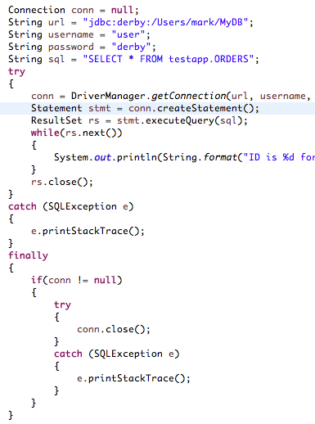
Can I see an example JDBC Query?
Database URL
and Login Credentials
Get a Statement from the Database Connection
Execute SQL Query and loop thru the ResultSet
Cleanup for sure in an Exception Finally Block

Slide 30
Can I see an example JDBC ResultSet?
Execute SQL Query and loop thru the ResultSet
ALWAYS close the ResultSet
Iterate through all the rows returned from the Query
Read a Column using proper data type getter method and the column name

Slide 31
In-Class Activity
Code JDBC Query API!
Finish In-Class Activity #4d (Part 2).

Slide 32
End of Class

Slide 33
Inserting and Updating using JDBC

Slide 34
How do insert/update data to a Database?
Connect to the Database and a desired schema.
Execute one or more SQL Insert/Update Statements.
Process number of rows or errors returns from the Database.
Close the connection to the Database.
Return number of rows to the Application.
This is similar to what you have been doing in PHP.

Slide 35
What JDBC Classes are used to Insert/Update Data?
Get a Connection using the DriverManager object.
Get a Statement object from a Connection.
Execute a SQL Insert/Update Statement from the Statement object.
Read number of rows from the Statement object (if supported).
Close the Connection to the Database.
Return the number of rows or error back to the Application.

Slide 36
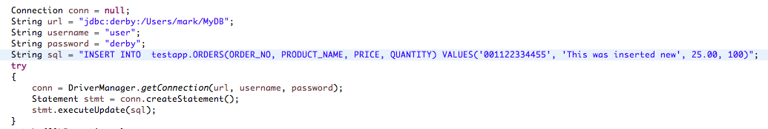
Can I see an example JDBC Insert?
Use the executeUpdate() on the Statement to do an insert and update
executeUpdate() despite its name executes both INSERT and UPDATE SQL statements.

Slide 37
In-Class Activity
Code JDBC API or Work on Project!
Finish In-Class Activity #4e.
Work on design and implementation of Milestone Project.

Slide 38
Weekend Reminders
Continue to work on the design and code for your Milestone Project.
Submit In-Class Activity #4e to the Main Forum.

Slide 39
End of Class

Slide 41
Lectures for Topic 4 – Week 3
Lecture:
Putting it all together.
Hands On:
Refactor code to use a Data Access Object.

Slide 42
What is a Data Service?
Controller Method
Standalone pure Java Classes.
Implements and encapsulates all (generally) database persistence logic.
Broken in CRUD methods (notice all are verbs).
Create – insert an entity
Read – query for one or list of entities (you may have multiple read/finder methods)
Update – updates an entity
Delete – deletes an entity
Persists your business entities.
No Business Logic or Business Rules goes here.
Can be reused across your application.
Calls
Business Services
Business Logic
Business Rules
Uses
Calls
Data Services
Create and Read
Update and Delete
Utility
Misc. Helpers

Slide 43
How do I create Data Services?
A Data Service should encapsulate all of your database persistence logic.
Make a Data Service for each Entity (user, product, etc.) you want to persist.
Create the appropriate CRUD methods for each Entity.
Implement as a Java Class.
You can even externalize your SQL statements in a configuration file.
Data Service
A
P
I
create();
read() and findBy();
update();
delete();
CRUD Methods
Create – inserts an entity
Read – reads single or list
Update – updates an entity
Delete – deletes an entity

Slide 44
In-Class Activity
Code JDBC API or Work on Project!
Finish In-Class Activity #4f.
Work on design and implementation of Milestone Project.

Slide 45
Weekend Reminders
Submit your Milestone #4 Project.
Submit In-Class Activity #4f to the Main Forum.

